Slide 1





Annual Interagency Accessibility Forum
Beyond Compliance: Building a Culture of Digital Accessibility
November 7-9, 2023
Accessibility Requirements Tool (ART)
Brianna Gomez McGowan

Slide 2

Today’s Agenda
What is Section 508
Why Accessibility Matters
Your Role in Section 508 Requirements
ART Enhancements & Demo
Questions

Slide 3

What is Section 508
The law applies to all Federal agencies when they develop, procure, maintain, or use ICT.
Notes:
Section 508 of the Rehabilitation Act of 1973 is a federal Law that states Information Technology. In 1998, Congress amended the 1973 Rehabilitation Act to include Information Communication Technology to include people with disabilities. The amended law strengthened Section 508, by establishing accessibility standards and requiring agencies to make their information and communication technology (ICT) accessible to people with disabilities by ensuring that the ICT meets the standards. This includes things like software as a service, web-sites, systems, hardware, keyboards, kios and one of my favorites is electronic documents. It applies to all Federal agencies when they develop, procure, maintain or use information communication technology (ICT).
In 2017 the 508 Standards were revised, like Chapters 1 and 2 (Appendix A), along with Chapters 3 through 7 (Appendix C), contain scoping and technical requirements for information and communication technology (ICT) to ensure accessibility and usability by individuals with disabilities. Compliance with these standards is mandatory for Federal agencies subject to Section 508 of the Rehabilitation Act of 1973, as amended (29 U.S.C. 794d).
Why do you think electronic documents is my favorite to mention when it comes to contracting?
Next slide

Slide 4




Why Accessibility Matters
Remediation
Modification
Deliverables
Lawsuits
Notes:
Why does Accessibility Matter? - It is all of our responsibility to ensure 508 requirements make it into our requirements for Information Communication Technology (ICT). The compliance with Section 508 falls primarily on the ordering level CO/CORs/PM’s. However I want to stress that it is everyone’s responsibility to ensure that any products/services are compliant. The other reasons 508 matters is because it is practical, reduces your workload, saves the government money, and is just the right thing to do to ensure everyone is able to their complete tasks, and are able to get the job done!
By using the ART Tool you are able to avoid and reduce the following four cost areas:
Remediation: 508 should be considered from the get-go, because if it’s not, remediation is then required. And unfortunately, it also increases the agency’s cost by up to 50% more than the original purchase, in order to course correct mid-project. This leads to my next point.
Modification: When section 508 requirements are included from ART in the beginning the need for Modifications of contract language are reduced. Saving you from having to spend added time and efforts on this purchase.
Deliverables: Including 508 language from ART ensures that deliverables are accessible and can be used by everyone, this includes federal employees and taxpayers who need to use our ICT that we procure.
Including Section 508 language provided by ART will ensure we reduce the amount of lawsuits the government receives, which also saves us money.
Next Slide

Slide 5
Your Role In Section 508 Requirements
Ensure Section 508 standards are considered in the acquisition planning documents and procurement requirements for ICT and that deliverables meet accessibility standards
Include appropriate Section 508 accessibility standards in requirements and acquisition planning documents and agreements
Notes:
Your main role is to use the ART Tool:
Ensure Section 508 standards are considered in the acquisition planning documents and procurement requirements for ICT and that deliverables meet accessibility standards
Include appropriate Section 508 accessibility standards in requirements and acquisition planning documents and agreements
Next Slide

Slide 6
ART Enhancements & Demo

Slide 7
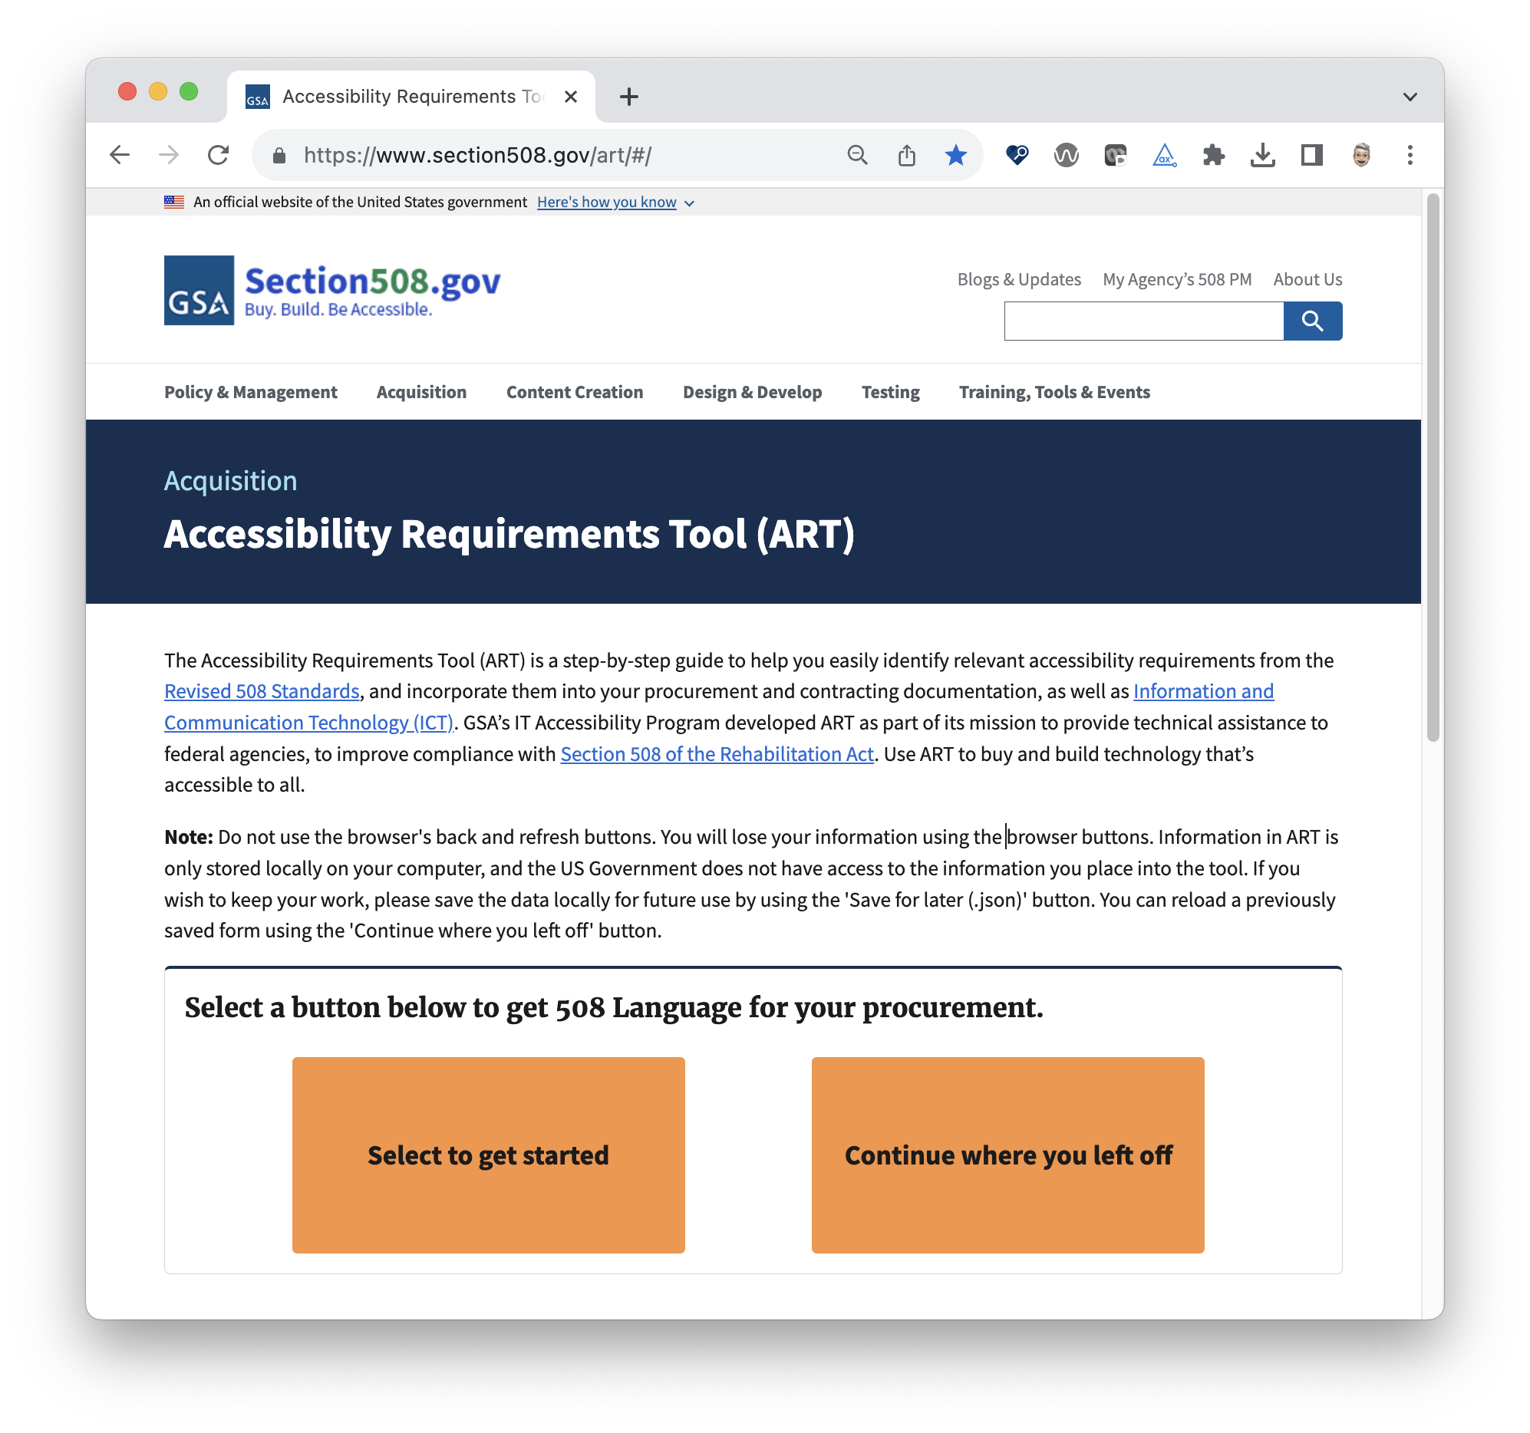
What is ART?
ART stands for
Accessibility
Requirements
Tool
ART’s Role in the Acquisition Process
Notes:
SPEAKER: What is ART?
The acronym stands for Accessibility Requirements Tool. ART is a multifaceted, step-by-step tool that offers interactive, step-by-step guidance on how to determine applicable accessibility requirements to then incorporate in your procurement documents, and be used for all in-house IT development.
A few of the goals for this tool when it was developed were to
Assist with ensuring information communication technology (ICT) purchases are accessible from the start by providing an easy step by step tool to develop Section 508 requirements
This tool also provides the necessary technical criteria in an exportable report format word docx
The ability to save progress mid-review, and continue the review later by uploading the saved, json file that allows you to return to the tool where you left off
ART’s Role in the acquisition process
Provide accurate section 508 requirements for the user to be included in their solicitation
Reduce remediation, modification and lawsuits
Provide a standardized option for agencies to ensure everyone is generated the section 508 requirements
Next slide - Bri I will turn it over to you

Slide 8
ART Enhancements
Reduce time to complete a procurement flow by 50%
Modernized from Drupal7 to the the latest framework, Angular14
ART can be launched from Section508.gov as a part of the Federalist
Open source on GitHub
The ability to save a completed form/review in multiple formats.
Comprehensive Glossary
Multiple options to download procurement document
Option to continue where user left off via JSON upload
Mobile launch
Ability to be integrated with other platforms and software
Notes:
SPEAKER: Some of the enhancements include…
Next Slide

Slide 9

ART Demo
Section508.gov/art
Notes:
SPEAKER:
ART will first ask about any potential exceptions, and if none apply, it will walk you through the criteria for each item in your procurement, and produce a report of the applicable standards and exceptions that apply to your procurement.
Next Slide

Slide 10
Incorporating Feedback
Continuously improving ART post launch
Since the launch of the enhanced ART, there have been demos to over 1,400 federal employees across 12 agencies.
Conducted User Acceptance Testing and have incorporated user requests, feedback, and corrections
Implementation of user requests to make ART user friendly, useful, and meaningful to get Section 508 language

Slide 11

Questions?

